Slide 1
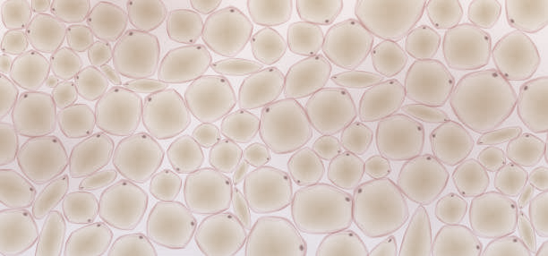
Entrance path
Mirror
Bounce 1
Bounce 2
Bounce 3
Bounce 4
Exit path
Tube lens
Objective
Exit mirror
Entrance mirror
SLM
Sensor
Tissue

Slide 2
Entrance
Bounce 1
Bounce 2
Bounce 3
Bounce 4
Bounce 5
Exit
Exit mirror
Entrance mirror
9.6 mm
15.4mm
SLM
Tissue

Slide 3
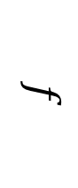

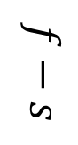
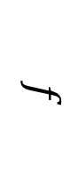
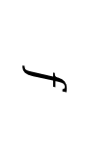
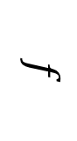
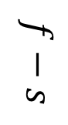

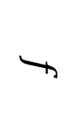
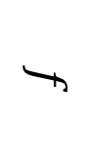

Mirror
Mirror
Mirror
$$f$$
$$f$$
$$f$$
$$f$$
$$f$$
$$f−s$$
$$f$$
$$f−s$$
$$d$$
$$d$$
$$d−2s$$
SLM
SLM
SLM

Slide 4
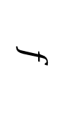
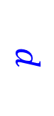
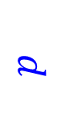
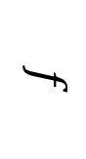
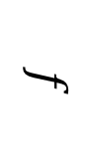
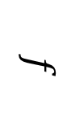
$$d$$
$$f$$
$$f$$
$$f$$
$$f$$
$$d$$

Slide 5
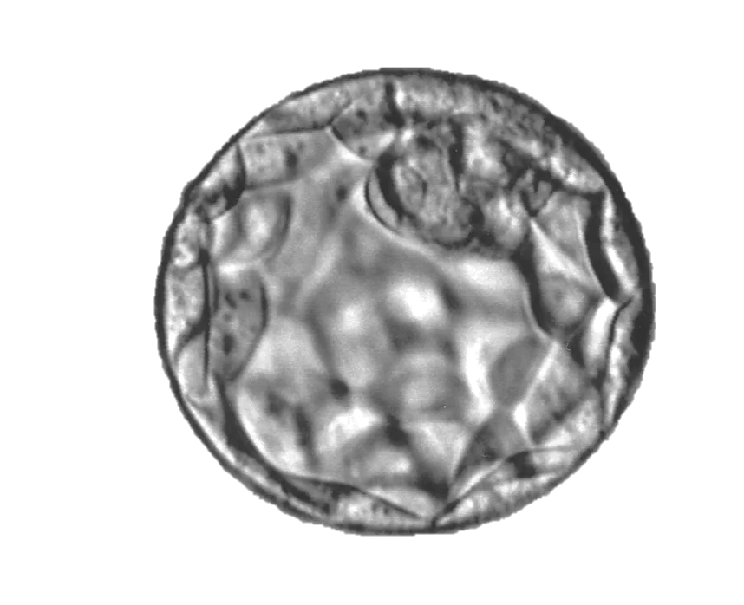
Dichroic filter
Beam splitter
Galvo tilt
Front laser
SLM
sample
Back laser
Front sensor
Back sensor

Slide 6
Dichroic filter
Beam splitter
Galvo tilt
Front laser
SLM
sample
Back laser
Front sensor
Back sensor

Slide 7
Front sensor
Back sensor

Slide 8
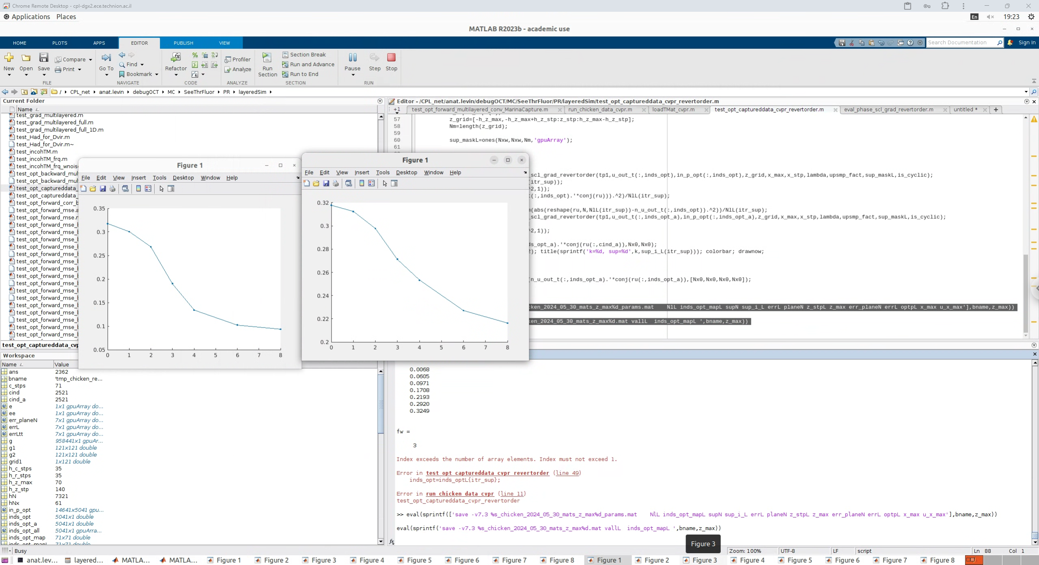
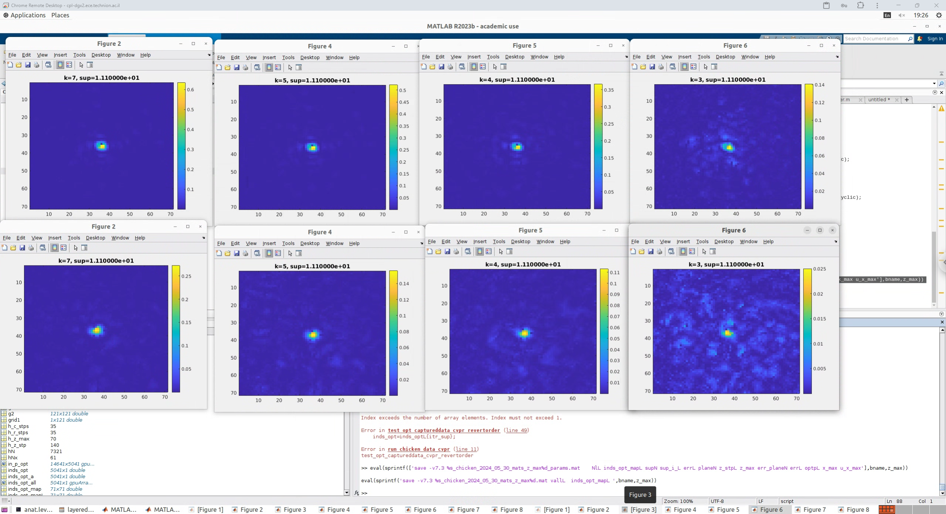

Slide 9

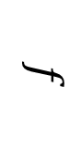
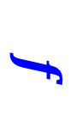
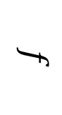
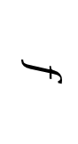
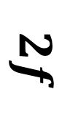
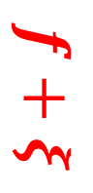


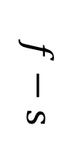
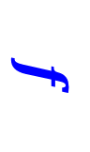
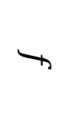
$$f$$
$$f+ξ$$
Mirror
Mirror
$$2f$$
$$f$$
$$f$$
$$f−ξ$$
$$f$$
$$f−s$$
$$f$$
$$f$$
$$d$$
$$d$$
SLM
SLM

Slide 10
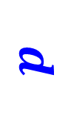


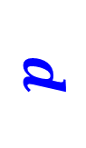


$$f$$
$$f+ξ$$
$$2f$$
$$f$$
$$f$$
$$f−ξ$$
$$f$$
$$f−s$$
$$f$$
$$d$$
$$d$$
SLM
SLM

Slide 11
$$f$$
$$f+ξ$$
$$2f$$
$$f$$
$$f$$
$$f−ξ$$
$$f$$
$$f−s$$
$$f$$
$$d$$
$$d$$
SLM
SLM

Slide 12

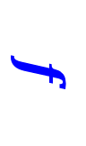

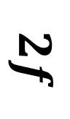
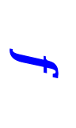

$$f$$
$$f+ξ$$
$$2f$$
$$f$$
$$f−ξ$$
$$f$$
$$f$$
$$d$$
SLM

Slide 13
$$f$$
$$f+ξ$$
$$2f$$
$$f−ξ$$
$$f$$

Slide 14
Mirror
Tube lens
Objective
Sensor
SLM
Tissue

Slide 15

Tissue

